Slide 1




IST 718 Final Project
Leticia Spencer
Yodit Ayalew
Rafal Rudzinski

Slide 2
Specification
Problem Statement
The World's Best Bookstore Inc. has hired Team 2 Data Scientist Inc. to find the best tool that is able to personalize book recommendations to customers based upon their interest, improving user experience.
Current methods of book recommendation tools are not aligned with the customer's interest.

Slide 3
Specification
Hypotheses
If WBB provides book readers with a recommender based upon reader ratings, then readers will have better more accurate book recommendations and a better user experience.

Slide 4
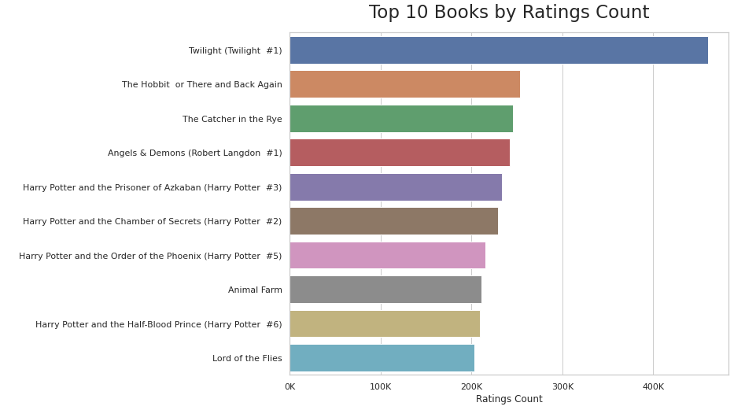
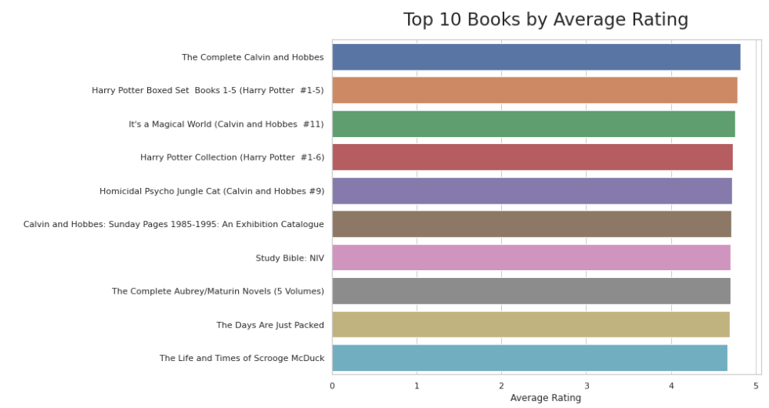
Observation
Books Dataset Observation
Total number of books: 10,000
Total number of ratings: 176, 953, 301
Book with most ratings: Twilight - 4,597,666 ratings
Book with highest average rating: The Complete Calvin and Hobbes - 4.82
50% of books have < 750 ratings while 25% have >5000 ratings,
subset data to only include data with 750+ ratings to avoid skewed data
Ratings Dataset Observation
Total number of ratings: 1, 048, 575
Percent of total ratings included in this dataset: 0.59%
Mean: 3.81
Median: 4.0
Total number of users in dataset: 13, 123

Slide 5
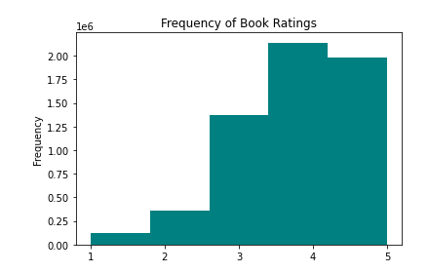
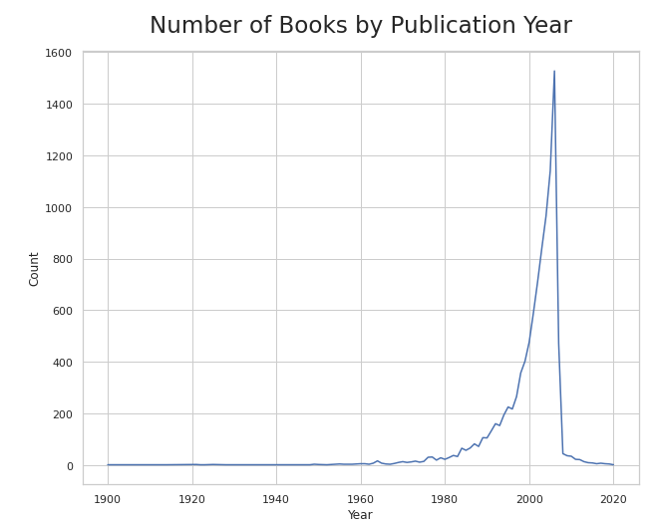
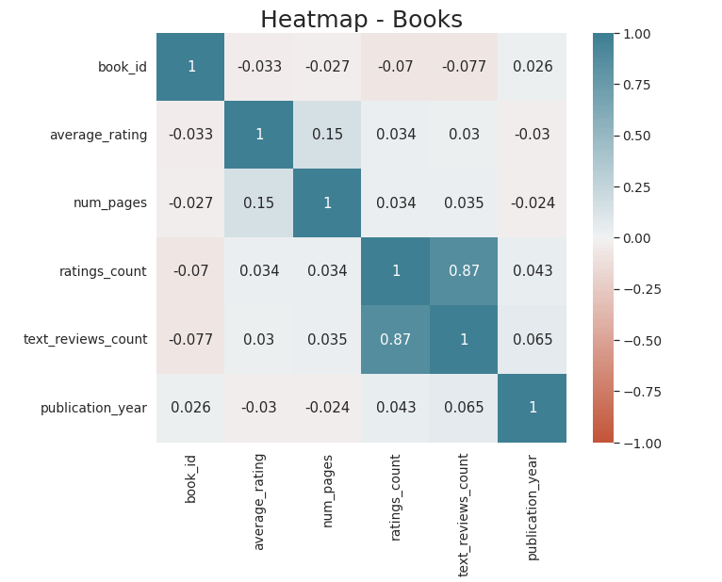
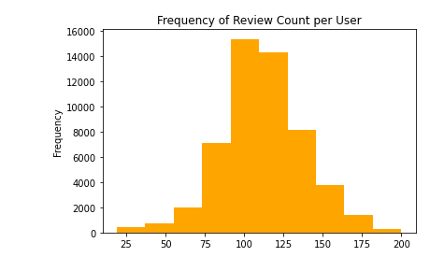
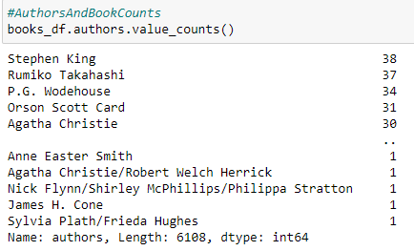
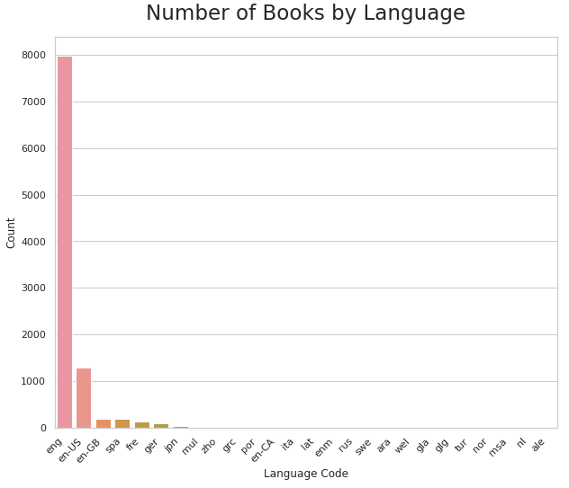
Observation

Slide 6
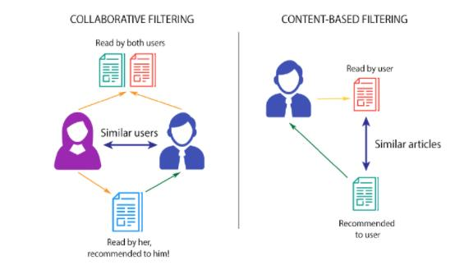
Analysis
Models
Correlation (Pearson's)
Collaborative - Item
Collaborative - User
Content Filtering

Slide 7

Analysis
To demonstrate the accuracy of the recommendation models, we used The Iliad by Homer as the input as well as users who have rated this novel.

Slide 8
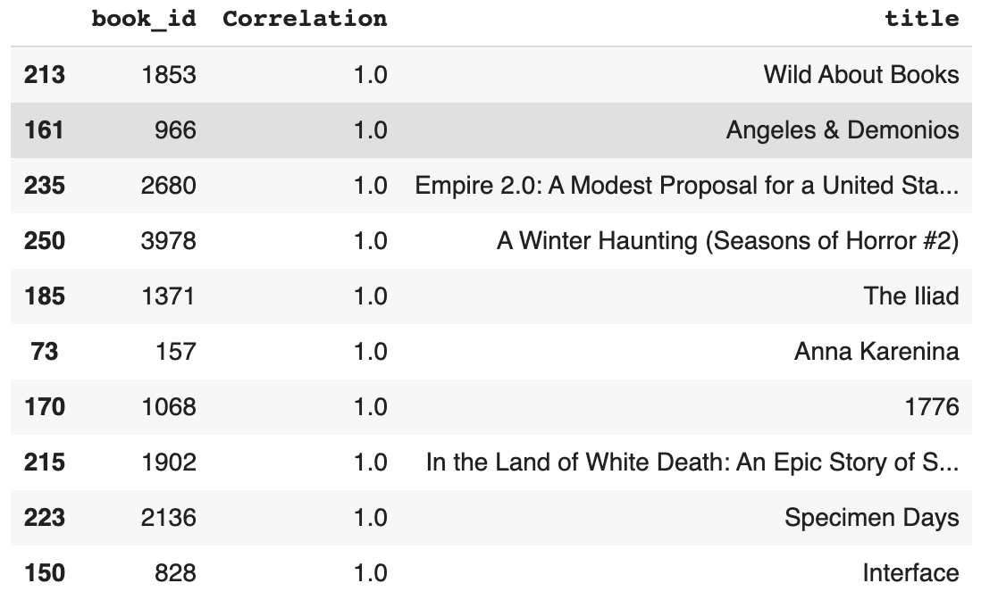
Analysis
Correlation Recommender
Highly correlated books using Pearson's correlation
Pros:
1. Simple model
2. Effective
Cons:
1. cold start
2. cause & effect

Slide 9
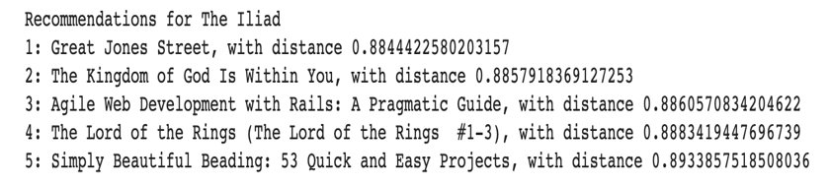
Analysis
Item-based CF
KNN – Unsupervised ML algorithm​
Similarity between books, pre-calculate similarity
Pros:
1. items are less dynamic
2. item-item comparison is more accurate
Cons:
1. Scalability
2. Sparsity

Slide 10
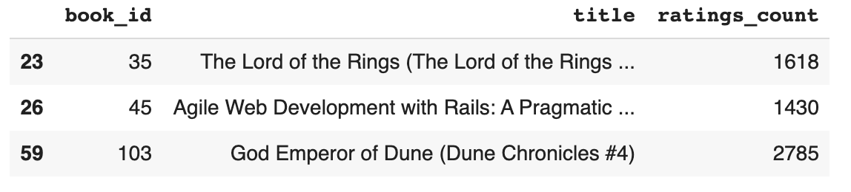
Analysis
User-based CF
KNN – Unsupervised ML algorithm
Similar people have similar tastes, k-nearest neighbor, cosine
Pros:
1. Easy implementation
2. Performance
Cons:
1. Scalability
2. Sparsity
3. New users have less information

Slide 11
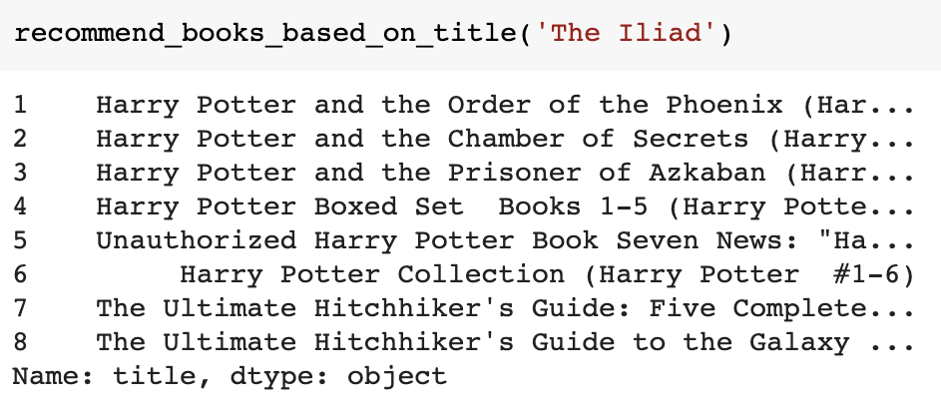
Analysis
Content-based
NLP – Unsupervised ML algorithm
Similarities based on title, vector-based, NLP
Pros:
1. No data from other users
2. Highly relevant to user
3. Quality not dependent on quantity
Cons:
1. Scalability
2. Highly dependent on tagging accuracy
3. May be subjective

Slide 12
Recommendation
Our analysis has concluded that a content-based model provides the most personalized recommendation of the 4 models tested.
Include more features (genres, book overview, author names) in the content model
A hybrid model, combination of 2 or more models may provide optimal recommendations but was not tested in this project.

Slide 13


Questions

